Slide 1
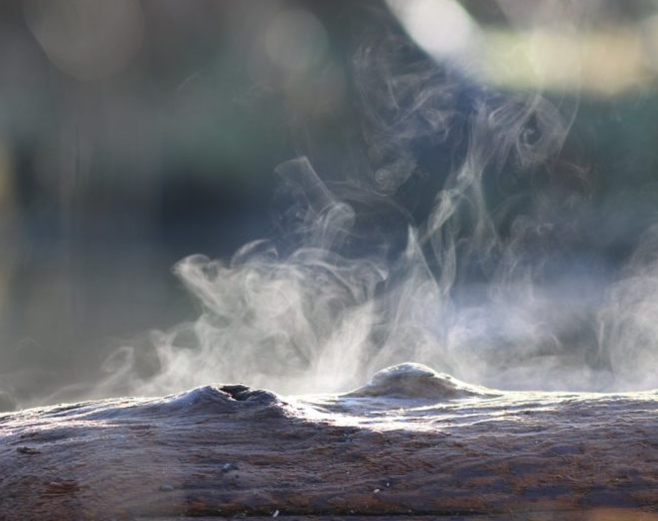
Structural Similarity in inverse problems
Why working together is better.
By: Teun Schilperoort

Slide 2
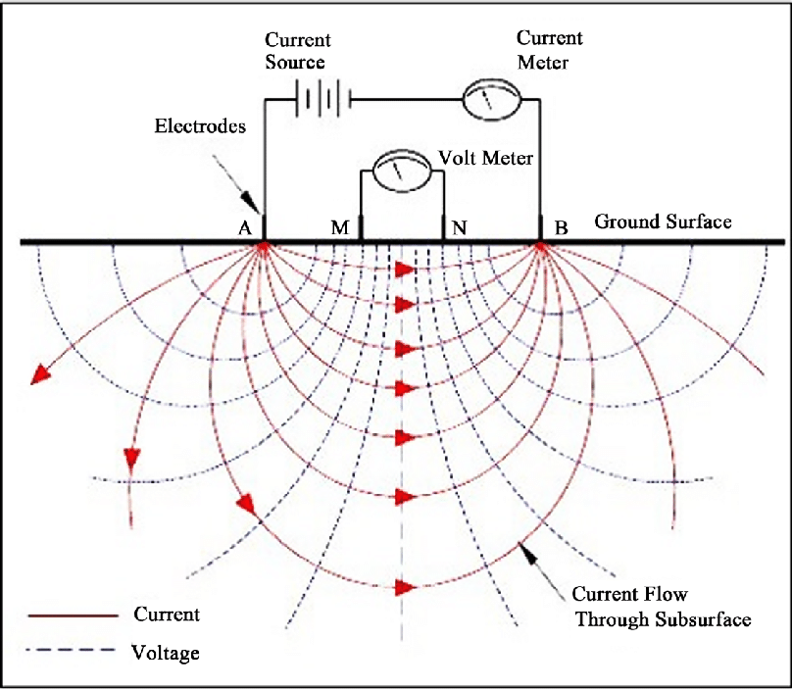
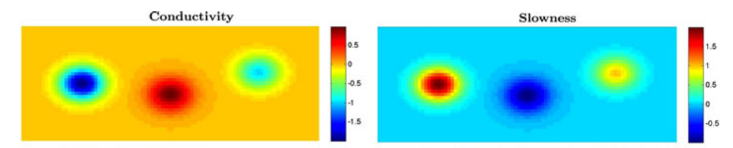
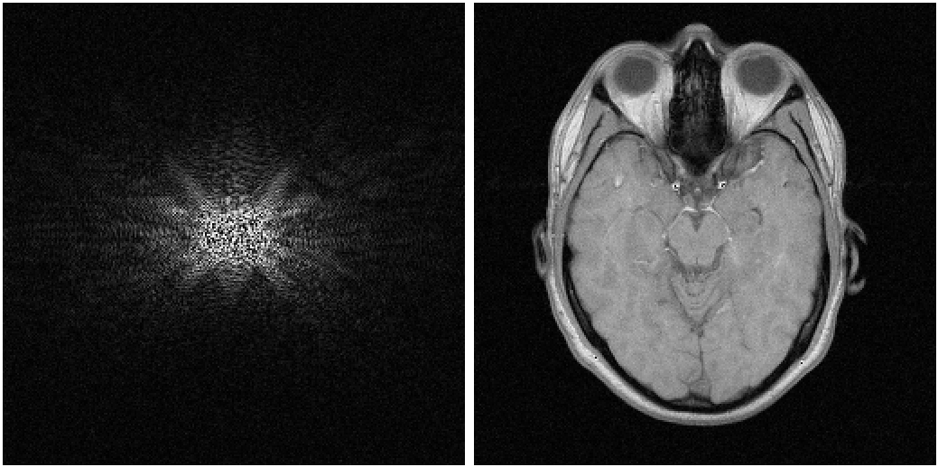
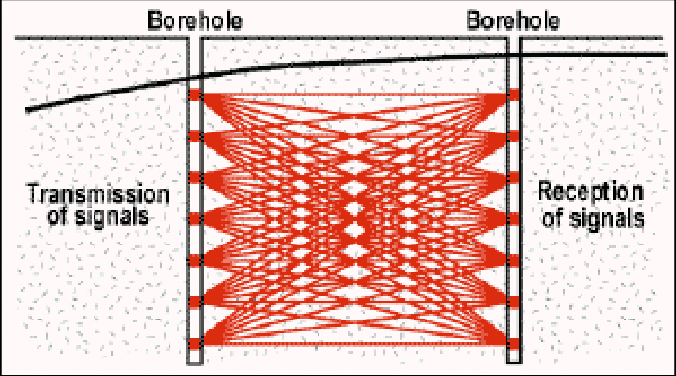
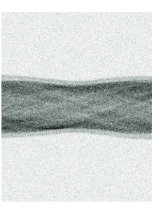
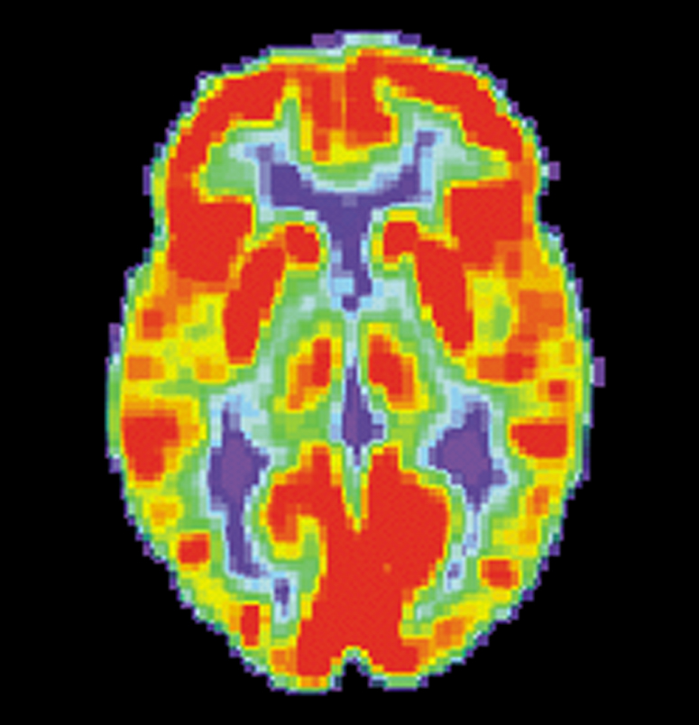
Geophysical Surveying
Medical Imaging
DC Conductivity
MRI scan
Borehole Tomography
PET scan

Slide 3
Inverse problems
System
Forward
Data
Inverse
“Infer model parameters from relevant observations”
Deconvolution, determining coefficients in ODE/PDE’s, seismographic imaging, MRI scans
In practice:
Ill-posed: No (unique) solution
Ill-conditioned: Small perturbations lead to large errors
Noisy data
Well-posedness: There is a solution continuously dependent on initial conditions

Slide 4

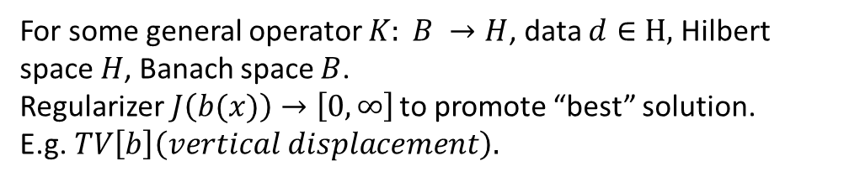

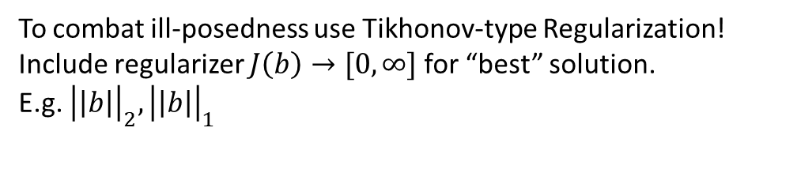
Variational optimalization
$$Minimize error:$$
$$\left||K\left(b\right)−d\right||_{2}^{2}, b∈R^{N}$$
For some general operator K and given data $d∈R^{n}$.
To combat ill-posedness use Tikhonov-type Regularization!
Include regularizer $J\left(b\right)→[0, ∞]$ for “best” solution.
E.g. ${\left|\left|b\right|\right|}_{2},{\left|\left|b\right|\right|}_{1}$
$$Minimize error:$$
$${{\left||K\left(b\left(x\right)\right)−d|\right|}^{2}}_{H}+J(b), b\left(x\right)∈B$$
For some general operator $K: B →H$, data $d∈H,$ Hilbert space $H$, Banach space $B$.
Regularizer$J\left(b(x)\right)→\left[0, ∞\right]$ to promote “best” solution.
E.g.$TV\left[b\right]\left(vertical displacement\right).$

Slide 5
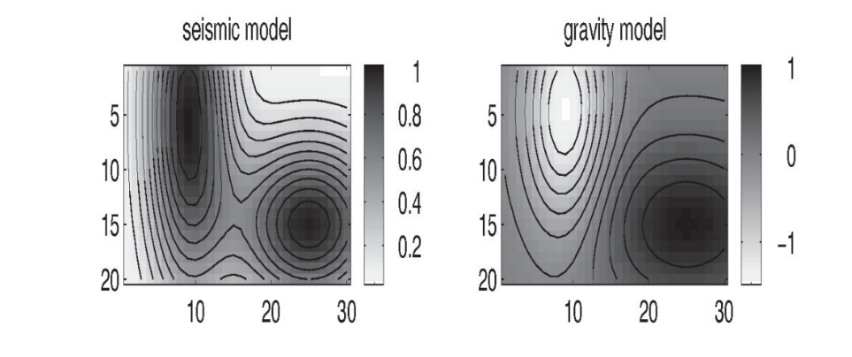
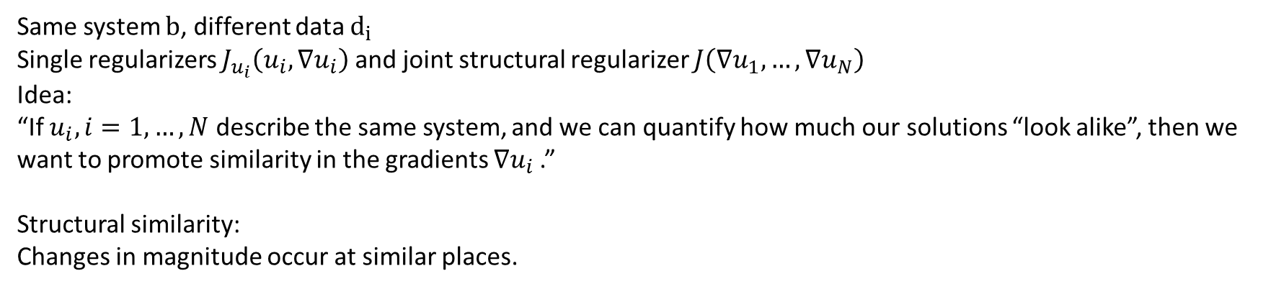
Joint inverse problems
Minimize over
$$\sum_{i=1}^{N}{{\left|\left|K_{i}\left(u_{i}\right)−d_{i}\right|\right|}_{ℋ_{𝒾}}^{2}}+J_{u_{i}}(u_{i}, ∇u_{i})+J\left(∇u_{1},…,{∇u}_{N}\right),u_{i}∈ℬ_{𝒾}$$
$$b≔\left(u_{1},…,u_{N}\right)∈ℬ$$
Same system $b$, different data $d_{i}$
Single regularizers $J_{u_{i}}\left(u_{i}, ∇u_{i}\right)$ and joint structural regularizer $J\left(∇u_{1},…, ∇u_{N}\right)$
Idea:
“If $u_{i}, i=1, …, N$ describe the same system, and we can quantify how much our solutions “look alike”, then we want to promote similarity in the gradients $∇u_{i}$.”
Structural similarity:
Changes in magnitude occur at similar places.
Haber, Holtzmann Gazit(1997)
Haber, Oldenburg(1997)

Slide 6
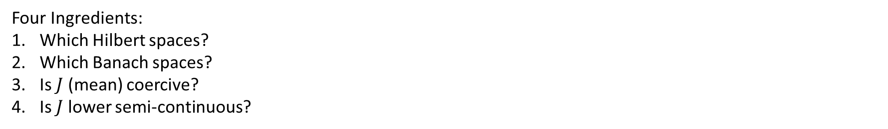
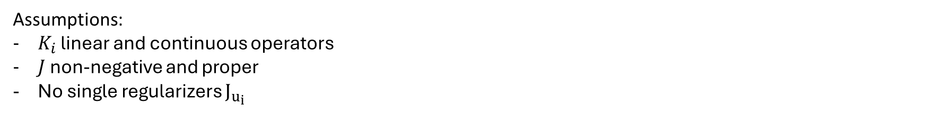
Theoretical
Minimize over
$$\sum_{i=1}^{N}{{\left|\left|K_{i}\left(u_{i}\right)−d_{i}\right|\right|}_{ℋ_{𝒾}}^{2}}+J\left(∇u_{1},…,{∇u}_{N}\right),u_{i}∈ℬ_{𝒾}$$
$$b≔\left(u_{1},…,u_{N}\right)∈ℬ$$
Four Ingredients:
Which Hilbert spaces?
Which Banach spaces?
Is $J$ (mean) coercive?
Is $J$ lower semi-continuous?
Assumptions:
$K_{i}$ linear and continuous operators
$J$ non-negative and proper
No single regularizers $J_{u_{i}}$

Slide 7
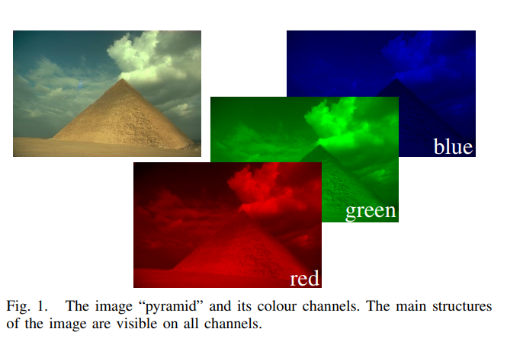
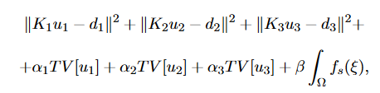
Numerical Testing
General joint inverse problem
Image enhancement: $N = 3, n = 2$
With $K_{i}$ blurring operators

Slide 8
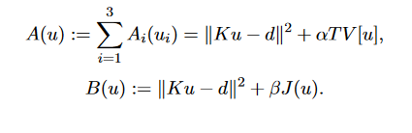

Method
Want to solve
Define new sub-problems
A is TV regularization and a standard convex optimalisation problem: Bregman method
B is continuous and non-convex optimalisation: L-BFGS-B method
Best algorithmic approach turns out to be: first solve A, then S

Slide 9
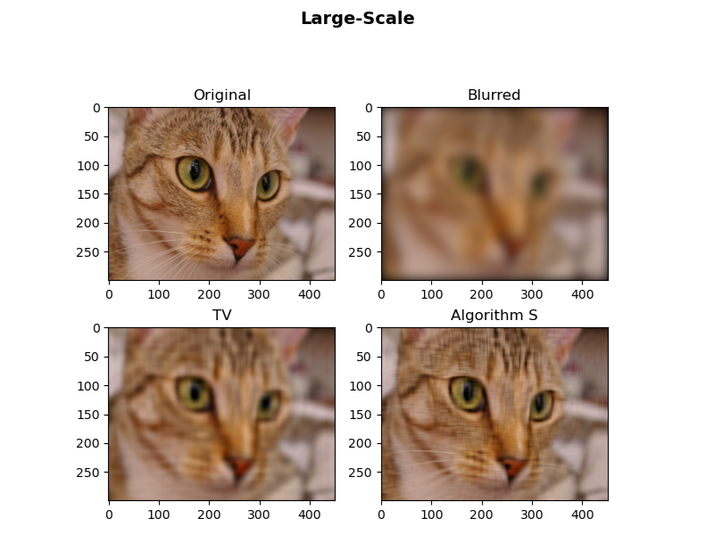
Numerical Results
Algorithm | PSNR | SSIM
TV | 26.8 | 0.67
S | 29.7 | 0.80
Fixed phantom phenomena in TV.
Noticeable increase visually and quantitatively!

Slide 10
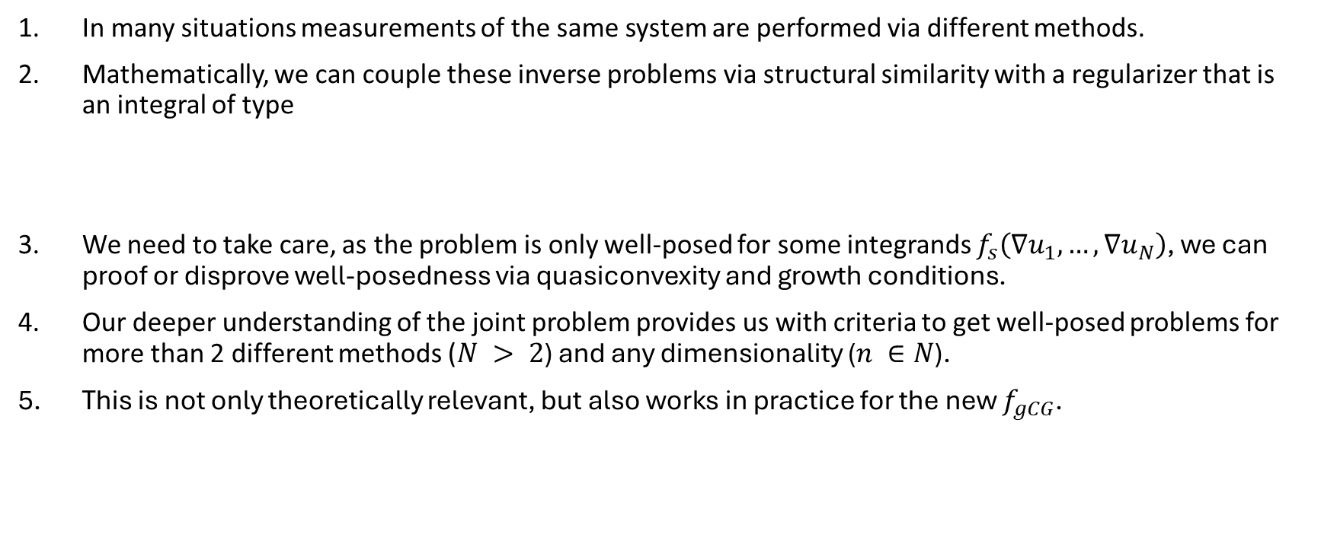
Take-aways
In many situations measurements of the same system are performed via different methods.
Mathematically, we can couple these inverse problems via structural similarity with a regularizer that is an integral of type
We need to take care, as the problem is only well-posed for some integrands $f_{s}\left(∇u_{1},…,∇u_{N}\right)$, we can proof or disprove well-posedness via quasiconvexity and growth conditions.
Our deeper understanding of the joint problem provides us with criteria to get well-posed problems for more than 2 different methods ($N > 2$) and any dimensionality ($n ∈N$).
This is not only theoretically relevant, but also works in practice for the new $f_{gCG}$.
$$J\left(u_{1},…,u_{N}\right)≔\int_{Ω}{f_{s}\left(x,u_{1}\left(x\right),…,u_{N}\left(x\right),∇u_{1}\left(x\right),…,∇u_{N}\left(x\right)\right)dx},Ω⊂R^{n}$$

